Slide 1
Xero - Final Presentation
Team 2
Zhuowen Yan (QA Manager)
Rahul Mendes (Business Analyst)
Shubham Mishra (Business Analyst)
Daulet Kapezov (QA Analyst)
Jill Pathak (QA Analyst)
Damin Milan Shah (Software Tester)
Laxman Madipadige (Software Tester)
Rishitha Mandali (Software Tester)
Sushanth Nandeti (Software Tester)
Zaid Akhtar Mohammad (Software Tester)

Slide 2
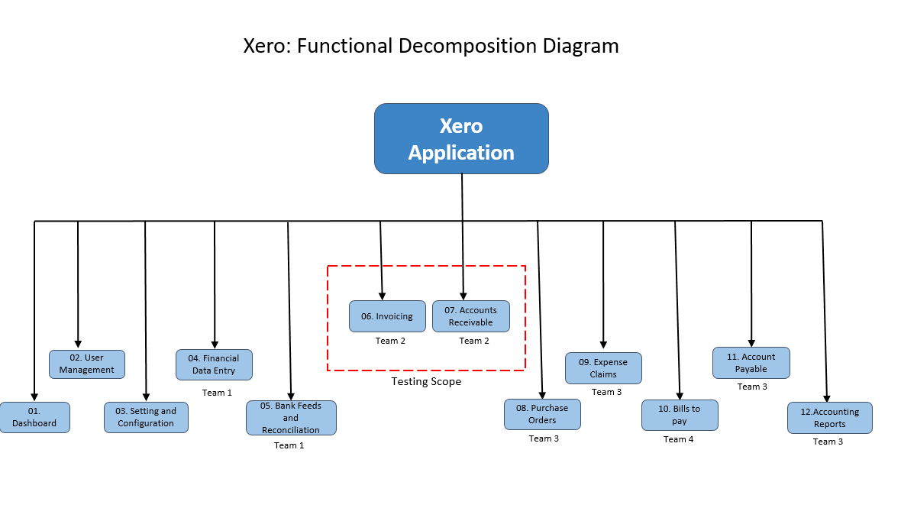
Functional Decomposition Diagram (by Shubham)

Slide 3
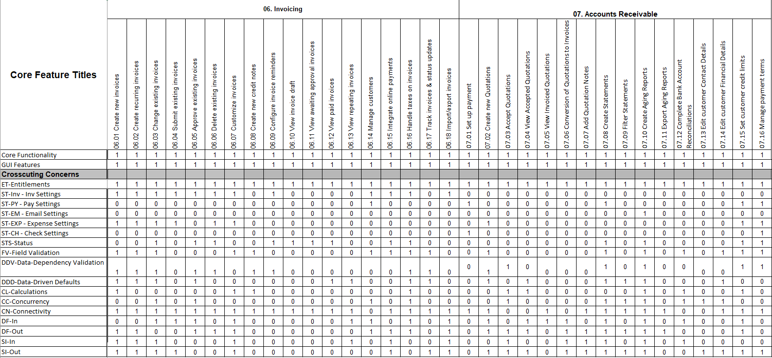
RCT (presented by Daulet)

Slide 4
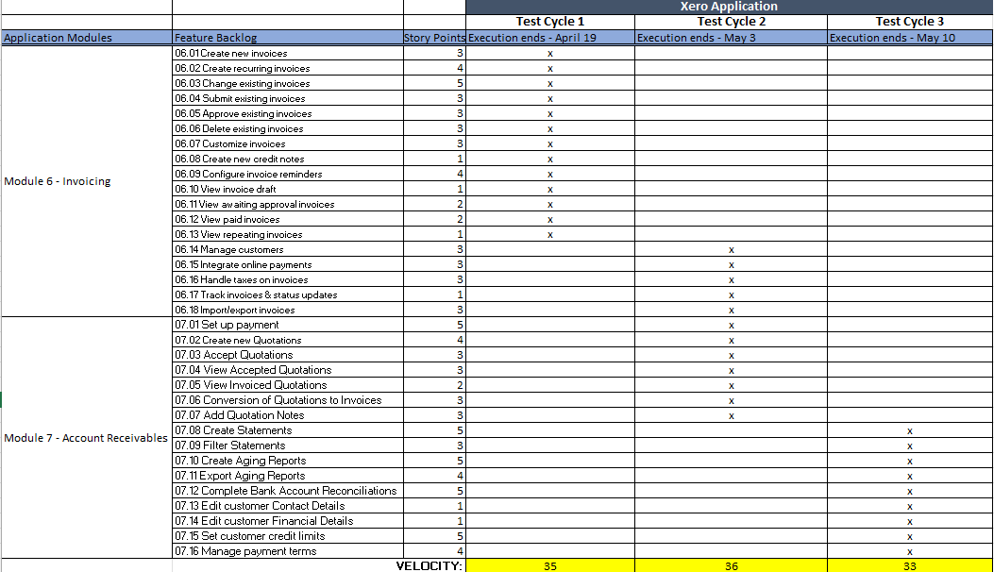
Testing RoadMap (presented by Rishitha)

Slide 5
Test Plan Document (presented by Rahul)
Test Scope:
Functional Area: Xero Web Application
Focus: Invoicing and Accounts Receivable Modules[06 and 07]
Technical scope: Web Browser, Application server, Database server
Test Objectives:
Validate functional & non-functional requirements
Core Features: Invoice creation, management, quotations, reporting
Non-Functional: Performance, security, usability, compatibility
Test Process:
Plan, Design, Preparation, Execution, Report
Black-box testing approach
Entry/Exit Criteria defined

Slide 6
Test Plan Document (presented by Rahul)
Test Environment:
Dedicated QA environment isolated from production
QTest for test management, version control
Data privacy measures in place
Roles & Responsibilities: QA Manager, QA Analyst, Business Analyst, Software Tester
Test Cycles & Schedule:
Cycle 1 (Apr 19): Invoicing Module Functionality
Cycle 2 (May 3): Customer & Quotation Management
Cycle 3 (May 10): Financial Reporting & Customer Management
Risks & Contingencies:
Too many acceptable defects will lower the overall quality
Personnel and testing resource constraints

Slide 7
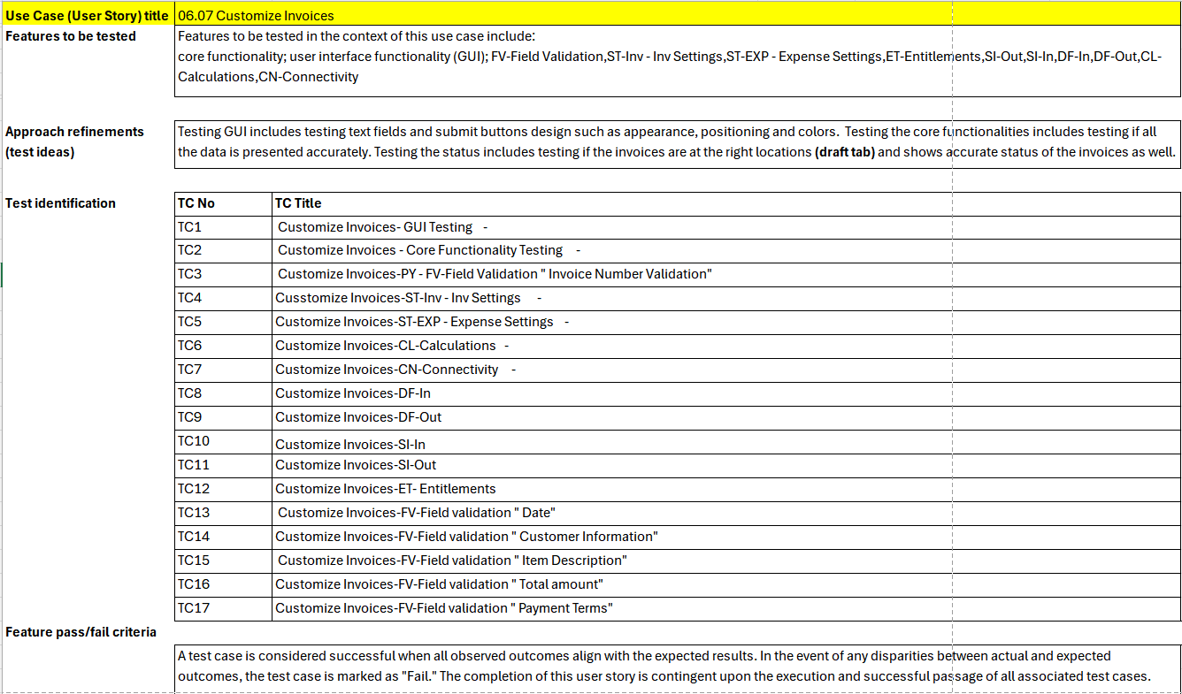
Test Design Specification (presented by Laxman)

Slide 8
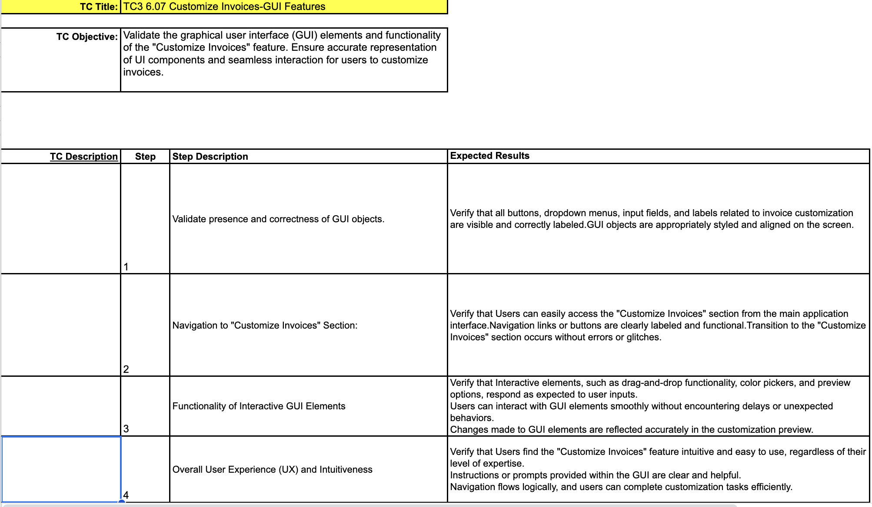
Test Cases Specification (presented by Jill)

Slide 9
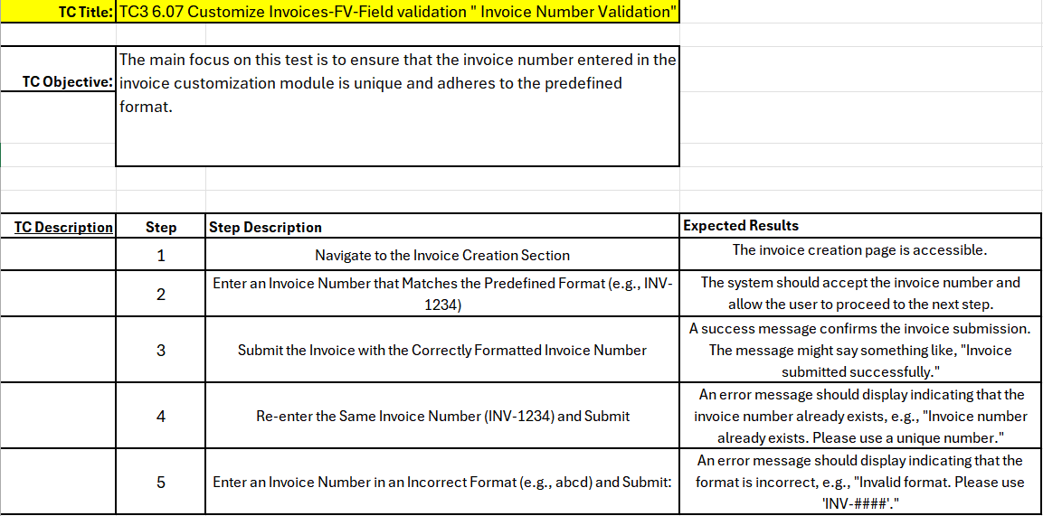
Test Cases Specification (presented by Zhuowen)
Tip: System should display a [negative] condition when you leave a mandatory field blank.

Slide 10
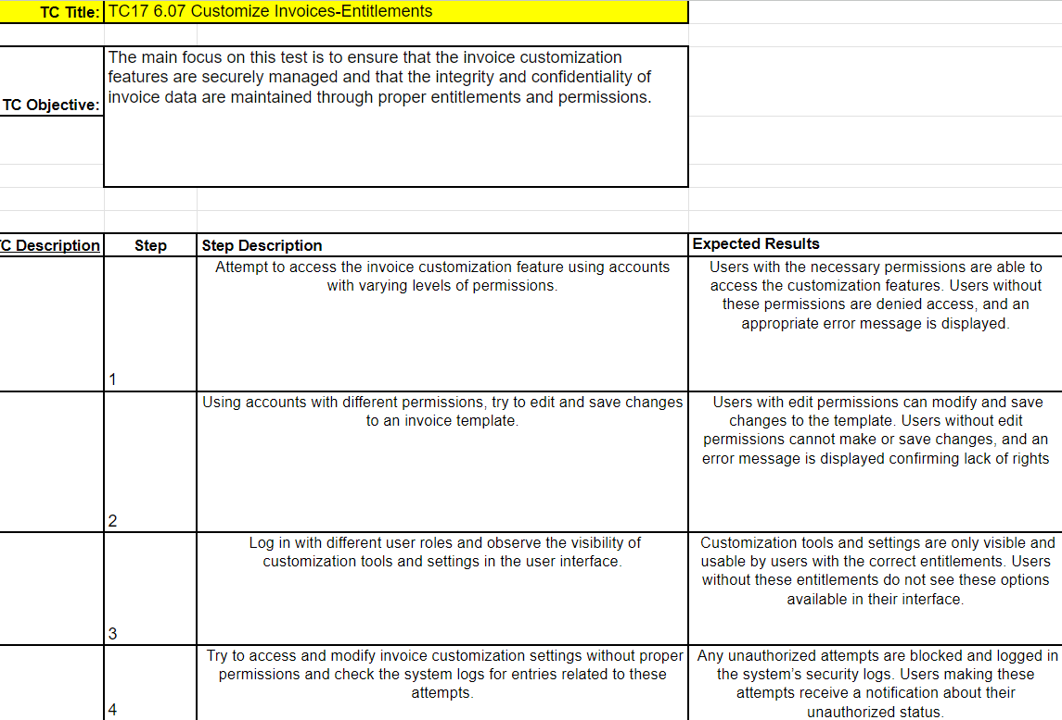
Test Cases Specification (presented by Zaid)

Slide 11
Test Summary Report (presented by Sushanth)
Introduction:
The Test Summary Report serves as a comprehensive documentation of testing activities conducted throughout the software development lifecycle. It communicates the outcomes of testing, including the number of test cases executed, pass/fail status, and identified defects' severity. Additionally, it evaluates whether testing objectives have been met, assesses software quality, and provides decision support for stakeholders. The report plays a crucial role in ensuring transparency, accountability, and confidence in the software development process, serving compliance and audit purposes while informing stakeholders about the software's readiness for deployment.
Metrics:
Test Cases Executed - 119 , Test Cases Passed - 109 , Test Cases Failed - 10
Types of Testing Performed:
Functional and Usability are the major types of testing performed.
Performance testing with minimal user count of 7-9.

Slide 12
Test Summary Report (presented by Sushanth)
Test Management and Defect Logging Tools :
JIRA and qtest
Browsers:
Chrome, Firefox, Safari, Brave
Best Practices:
Detailed documentation - Thorough documentation of test cases, procedures, and outcomes ensures clarity and transparency throughout the testing process.
Utilizing the testing tools efficiently - Proper utilization of testing tools such as JIRA and qTest optimizes testing workflows, improves productivity, and facilitates collaboration among team members.
Effective bug reports and tracking - Comprehensive tracking of bugs ensures that no issues are overlooked and helps maintain a clear audit trail of bug resolution activities.
Lessons Learnt:
Set realistic deadlines and track the progress efficiently.
RCT Accuracy - Ensuring accuracy in Requirement Traceability Matrix (RCT) helps maintain alignment between test cases and project requirements, minimizing the risk of missing test coverage and enhancing overall testing effectiveness.

Slide 13
Test Summary Report (presented by Sushanth)
Exit Criteria:
● All test cases have been executed. – Yes
● All test cases have passed or have acceptable justifications for failures. – Yes
● All defects have been reported and verified. – Yes
● All defects of Critical, Major, and Medium severity are either resolved or will make an acceptable mitigation plan. – Yes
Conclusion:
The Testing team confirms the application's readiness for deployment after meeting all exit criteria, ensuring comprehensive testing of the Invoicing and Account Receivables modules in the Xero application

Slide 14

Recorded Application Demo (Recorded by Damin)

Slide 15
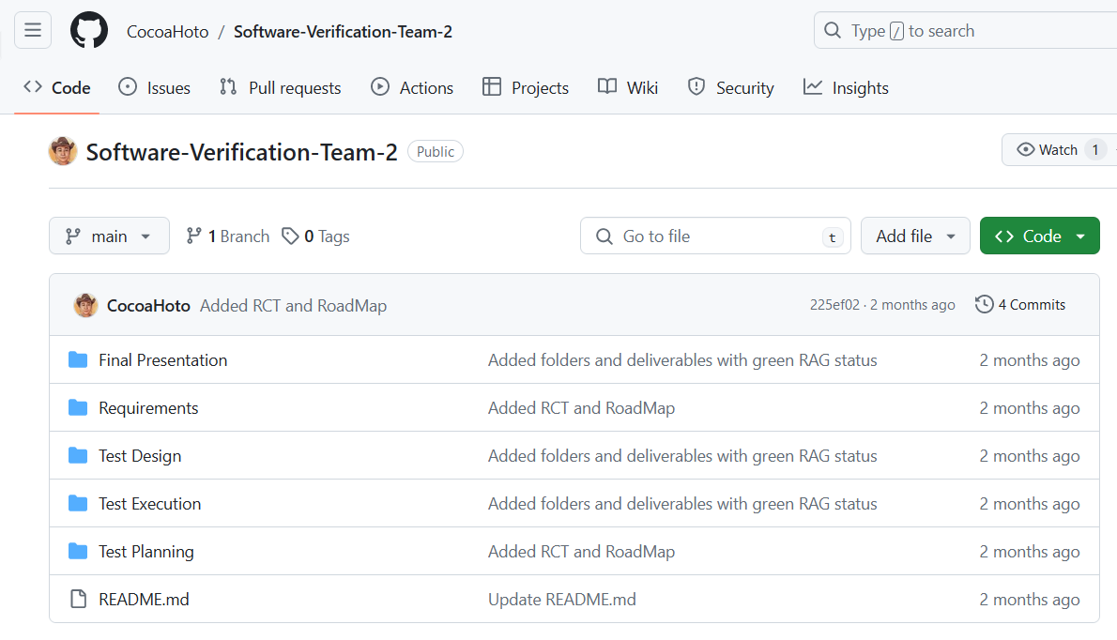
Github Repository
https://github.com/CocoaHoto/Software-Verification-Team-2

Slide 16
Thank You!
Team - 2

